Slide 1
Leading and Managing Change
Capacity Evaluation
Content Originally Created by Doug Moeckel with KASB and USA-K
Notes:
This content was created by Doug Moeckel with KASB for the initial leadership training all new redesign schools undergo in August of their plan year. The training content was adapted by the KSDE Redesign team for the purposes of this presentation.

Slide 2
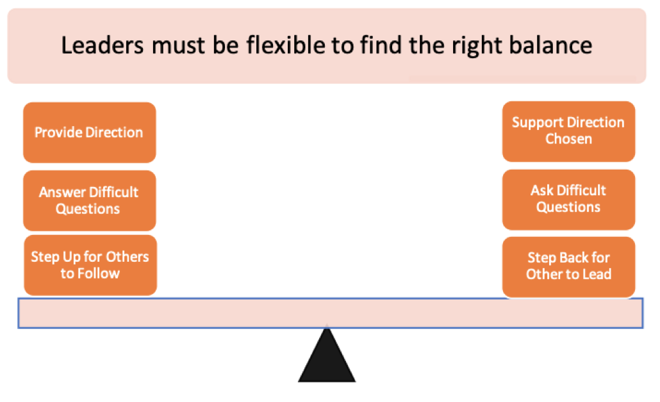
What is your role as a leader?
Reflect- How are you doing in striking the right balance?

Slide 3
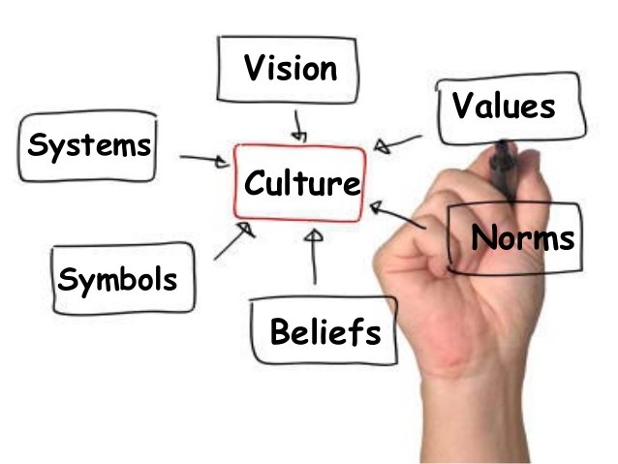
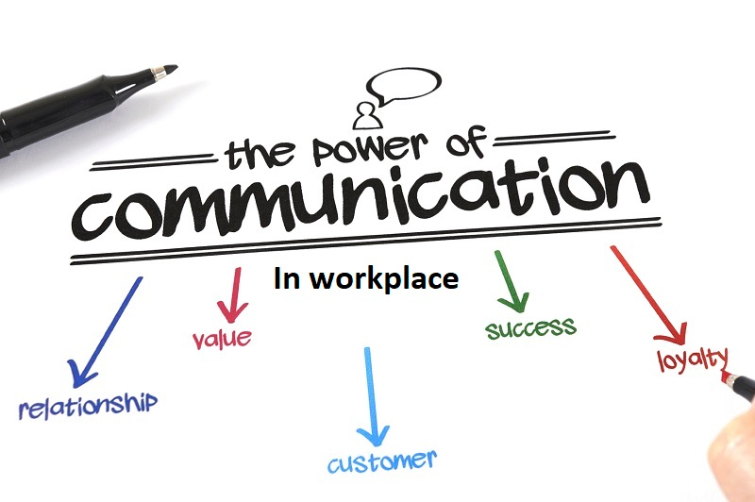
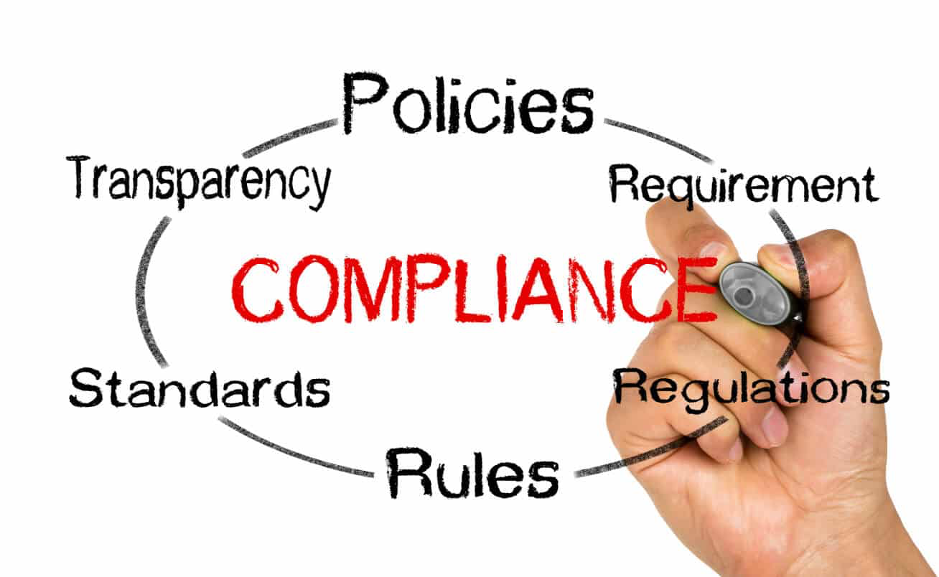
How are you addressing CCOI?
C
C
O
I
Order
Input
Notes:
Culture, Communication, Order, Input
For the purposes of this presentation, we will focus on how you as a leader are growing your leadership capacity (i.e. modeling learning leadership) as it relates to CCOI.

Slide 4
Culture

Slide 5
Technical Challenges
Solutions applied with technical knowledge
Top down management
Directive Leadership
Assigning Roles, setting expectations, monitoring, guiding performance.
Requires….
Defined ideals and beliefs
Defined purpose
Root issues identified
Empowering Leadership
Sharing responsibility, encouraging dissent and innovation
Adaptive Challenges
Solutions outside current modes of operation
Professional learning
Bottom up leadership
Complexity of Change
Notes:
KSDE Redesign defines ‘modeling learning leadership’ as ‘Leaders continue to grow and learn through professional development and coaching. Leaders encourage staff and students to participate in decision-making, and they develop the leadership potential in others. Leaders model effective practice and work to build and maintain trust.’
Here, that corresponds with ‘Empowering Leadership’. As you lead your school through the complex changes that come with Redesign, and the associated adaptive challenges’, you will want to model learning leadership by becoming an empowering leader.
This dedication to empowering leadership will help you establish a strong culture that is ready and able to work through complex change.

Slide 6
4 P’s of a New Beginning
Four P’s | What people need | What leaders need to do
Purpose (WHY) | Understand the purpose behind the outcome. | Explain the purpose.
Picture (WHAT) | See what the outcome looks and feels like. | Show the picture.
Plan (HOW) | Have a plan for how to get from here to there. | Lay out the plan.
Part (PEOPLE) | Have a part in the plan and the outcomes. | Allocate the part.
Reflect- How well are you sharing leadership to solicit input around the 4 Ps?
(Bridges, 2003)
Notes:
As a leader, your job is to establish strong messaging and feedback loops around the 4 Ps. Thinking about these four Ps will help you sustain a culture ready for change. As you move through the next three elements (communication, input, and order) don’t forget about how you are managing these 4 Ps.

Slide 7
Communication

Slide 8
Why People Adopt New Ideas:
 | The degree to which an innovation…
Relative Advantage | is perceived as better than the idea it supersedes
Compatibility | is perceived as consistent with the existing values, past experiences, and needs of potential adopters
Complexity | is perceived as not difficult to understand or use
Trialability | may be experimented with on a limited basis
Observability | is implemented and the results of the implementation are visible to others
The rate of adoption and utilization of new ideas and innovations is influenced by how they are perceived and how they are framed (Rogers, 2003).
Notes:
Messaging around change is critical to its success. Read through these reasons before moving on to the next slide.

Slide 9
Why is Redesign better?
List three advantages.
1.
2.
3.
Notes:
It is important that you consistently communicate the relative advantage to stakeholders.

Slide 10
Think about specific messages that you have sent to influence individuals to adopt your changes. What reason was supported through your message?
 | The degree to which an innovation…
Relative Advantage | is perceived as better than the idea it supersedes
Compatibility | is perceived as consistent with the existing values, past experiences, and needs of potential adopters
Complexity | is perceived as not difficult to understand or use
Trialability | may be experimented with on a limited basis
Observability | is implemented and the results of the implementation are visible to others
Notes:
In addition to relative advantage, you will also want to consider how you have addressed (or continue to address) the other elements.

Slide 11
Input
Notes:
This section will focus on how you engage staff in change. In this section, we will talk about the different types of individuals in an organization and the methods you will need to utilize in order to engage them in the change process.

Slide 12
Everett Rogers
Rogers is known as the “father of diffusion of innovation research.”
Diffusion is the means by which new ideas or innovations are spread among members of a social system over time.
The decision-making process comprises five stages:
Knowledge
Persuasion
Decision
Implementation
Confirmation

Slide 13
Decision Making Stages for Adopting Innovation
Knowledge
An individual understands what it is, how it works, and why it works
Persuasion
An individual forms a favorable or an unfavorable attitude towards the innovation
Decision
An individual engages in activities that lead to a choice to adopt or reject an innovation
Implementation
An individual puts an innovation to use
Confirmation
An individual seeks reinforcement for the innovation decision
(Rogers, 2003)

Slide 14
How are you soliciting input through each phase of the decision making process?
Knowledge
An individual understands what it is, how it works, and why it works
Persuasion
An individual forms a favorable or an unfavorable attitude towards the innovation
Decision
An individual engages in activities that lead to a choice to adopt or reject an innovation
Implementation
An individual puts an innovation to use
Confirmation
An individual seeks reinforcement for the innovation decision

Slide 15
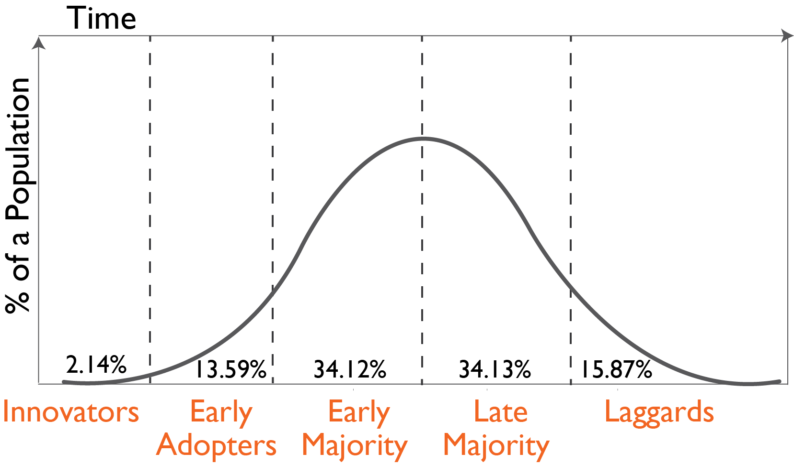
Rates at which Individuals Adopt Innovation
There are five adopter categories:
Innovators
Early Adopters
Early Majority
Late Majority
Laggards
Diffusion of Innovations (Rogers, 2003)

Slide 16
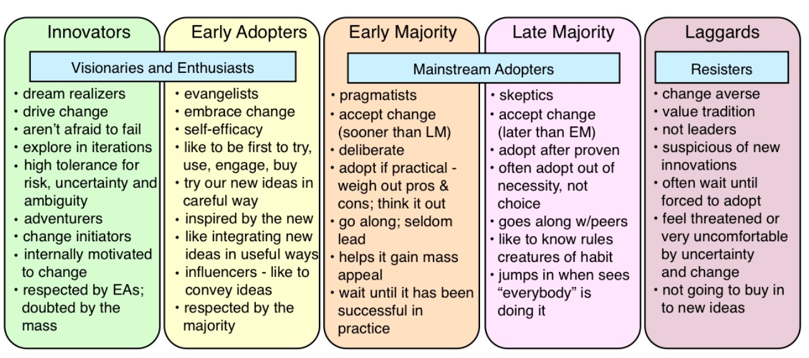
It is important to identify an influential group to move to the Early Majority.
Reflect- Are you getting input from each adopter group? How are you using input from each group to move your people to change?

Slide 17
Knowledge Diffusion Technique:
Working with Influentials and Opinion Leaders

Slide 18
Opinion Leaders...
Have the capacity to persuade others
Enjoy informal position and status
Get around
Have credibility
Earn and maintain status
Are activists
(Rogers, 2003)

Slide 19
Groups of Influentials:
Role Models
Technical Experts
Power People
Cheerleaders
Celebrities
Note: Influentials are not Opinion Leaders on every issue.
Who are the influentials in your organization? How are you using them to move your innovation forward?

Slide 20
Order
Notes:
This last section focuses on order. Now that you know who you are leading and how to communicate effectively with them, you will need to also focus on how the process of change will be maintained. How will you ensure that change does not create chaos and confusion?

Slide 21
William Bridges
Bridges makes a distinction between change and transition.
Transition is a psychological process and transitions take more time to process.
Changes are external and transitions are internal.
A transition includes three distinct phases:
Ending – loss and grieving for what is gone
Neutral zone – chaotic and frustrating
New beginning – acceptance and new understandings

Slide 22
Transition Process
Ending
(dying)
Neutral Zone
(chaos)
New
beginning
(renewal)
(Bridges, 2003)

Slide 23
Begins with an Ending
(Bridges, 2003)

Slide 24
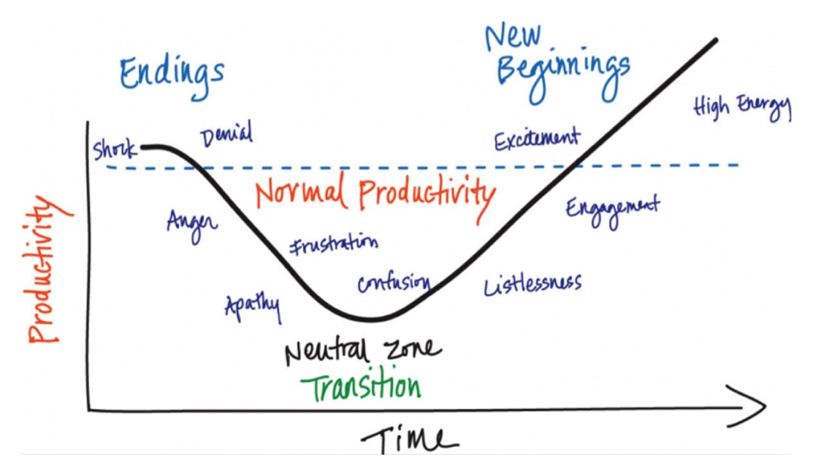
Neutral Zone
Nothing seems to work
Production dips
Both creativity and chaos are possible

Slide 25
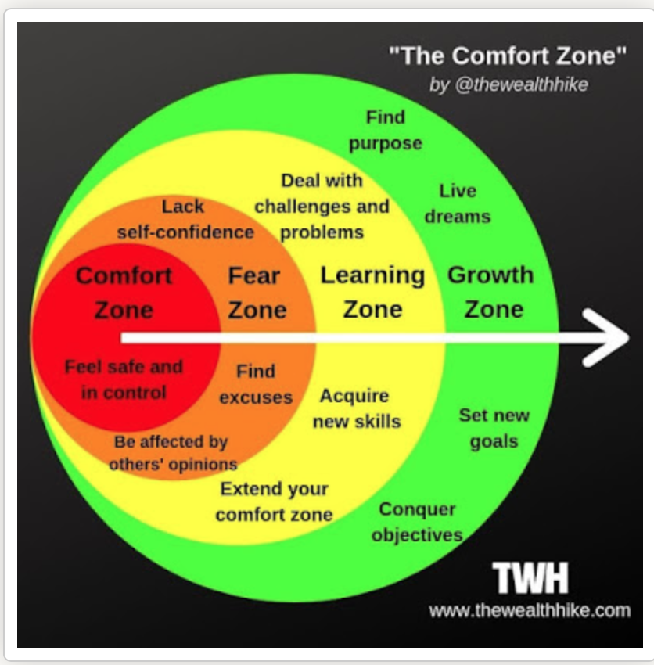
New Beginnings
Developing new understandings, new values, new attitudes, and new identities
Making a commitment to the new way
Being willing to take a risk that the new way will work

Slide 26
Transition Process
Ending
(dying)
Neutral Zone
(chaos)
Reflect- How are you managing transitions to maintain order in your school?
New
beginning
(renewal)
(Bridges, 2003)

Slide 27
How are you addressing CCOI to Model Learning Leadership?
C
C
O
I
Order
Input
Notes:
Culture, Communication, Order, Input

Slide 28
KSDE Redesign Team - redesign@ksde.org
Jay Scott - jscott@ksde.org
Tammy Mitchell - tmitchell@ksde.org
Sarah Perryman - sperryman@ksde.org

